Slide 1
Intro to Coding with Python– Prototyping
Dr. Ab Mosca (they/them)
Slides based off slides courtesy of Jordan Crouser (https://jcrouser.github.io/)

Slide 2
Plan for Today
User-centered design
What it is
Why do it
Ways to do it
Life skill #1: paper prototypes
Life skill #2: architecture diagrams

Slide 3
Hypothetical example
“Advising Assistant”

Slide 4
Hypothetical example
Overview: over 100 majors and minors in DCIS
Image © JOHN TRABBIC III, Storyboard Artist / Cartoonist
Notes:
This year, CSC major hit a 30-year record:
18&18J: 33M + 3m, graduating this May. 19&19J: 41M + 1m 20&20J: 39M + 3m 21&21J: 1M

Slide 5

Hypothetical example
Overview: three advising faculty

Slide 6
Hypothetical example
Overview: BannerWeb not hugely helpful…
Notes:
When I log into bannerweb I can see my advisees, but there’s no way to track their progress toward completing the major.

Slide 7
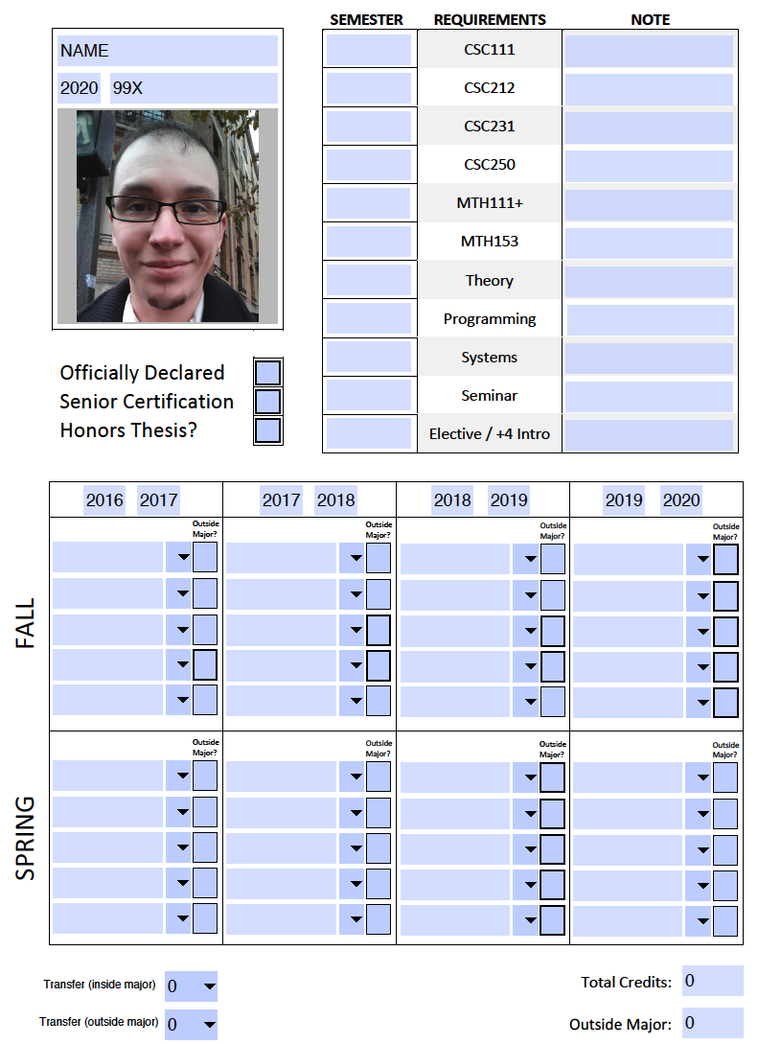
Hypothetical example
Overview:
current process
is manual
Goal 1:
detect which courses a student has taken that count toward the major
Goal 2:
give adviser an overview of all advisees
Notes:
This worked really well when I had 10 or so advisees, but now I have 43!

Slide 8
Hypothetical example
Ideal: we would like to build a plugin that sits on top of Banner and does everything for us, but that won’t work because of FERPA concerns (can’t alter Banner)
Actual strategy:
Define mapping from course numbers to major/minor designation
Export CSV of all advisees from Banner
Build a parser that extracts data from unofficial transcript (i.e. courses taken) and joins with mapping, majors/minors
Build authenticated frontend for adviser to track student progress, as well as (maybe) send messages / schedule appointments

Slide 9
Hypothetical example
Ideal: we would like to build a plugin that sits on top of Banner and does everything for us, but that won’t work because of FERPA concerns (can’t alter Banner)
Actual strategy:
Define mapping from course numbers to major/minor designation (core, T|S|P, seminar, etc.)
Export CSV of all advisees from Banner
Build a parser that extracts data from unofficial transcript (i.e. courses taken) and joins with mapping, majors/minors
Build authenticated frontend for adviser to track student progress, as well as (maybe) send messages / schedule appointments

Slide 10
Discussion
Let’s say you wanted to actally implement this;
where do you start?

Slide 11
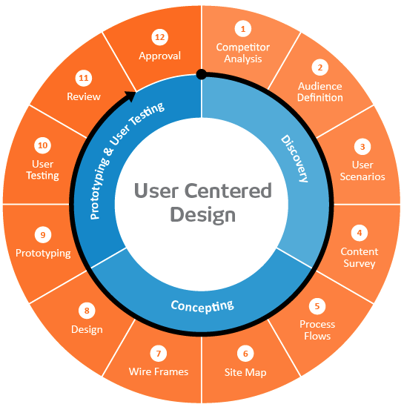

User-centered design framework
1) Discovery
Learning about your users
Modeling your users
Analyzing your users’ tasks
Eliciting and defining clear product requirements
2) Concepting Phase
Developing conceptual models
Solving design problems through ideation
Detailed design activities
3) Prototyping + User Testing
Delivery of a high-quality product that meets users’ needs and is easy to learn and use
Users
http://www.uxmatters.com/mt/archives/2010/07/design-is-a-process-not-a-methodology.php
Notes:
All Phases
Each phase feeds into the next
Iteration is key!
Users involved at all phases of the process

Slide 12
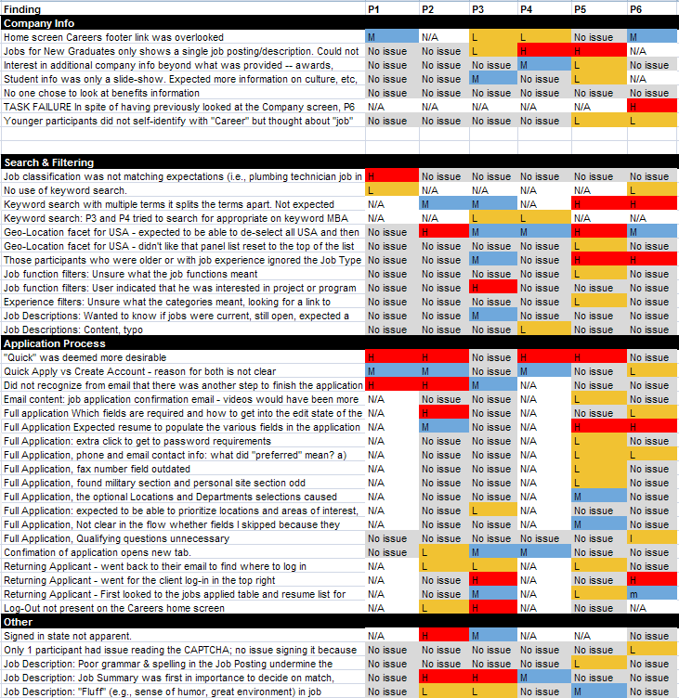
Competitive review
Why?
If you look at what already exists, you might be able to identify potential issues in advance
Also helps establish your unique contribution
How?
Literature or product review
Analysis
What are the existing tools?
What is their purpose?
What audience are they aiming for?
What kinds of strategies are they using?
What functionality do they contain?
What are their strengths and shortcomings?
Identify opportunities and design constraints

Slide 13
Defining your audience
Learning about their problem
Semi-structured interview
Analyzing their tasks
Hierarchical task analysis
Modeling users
Personas

Slide 14
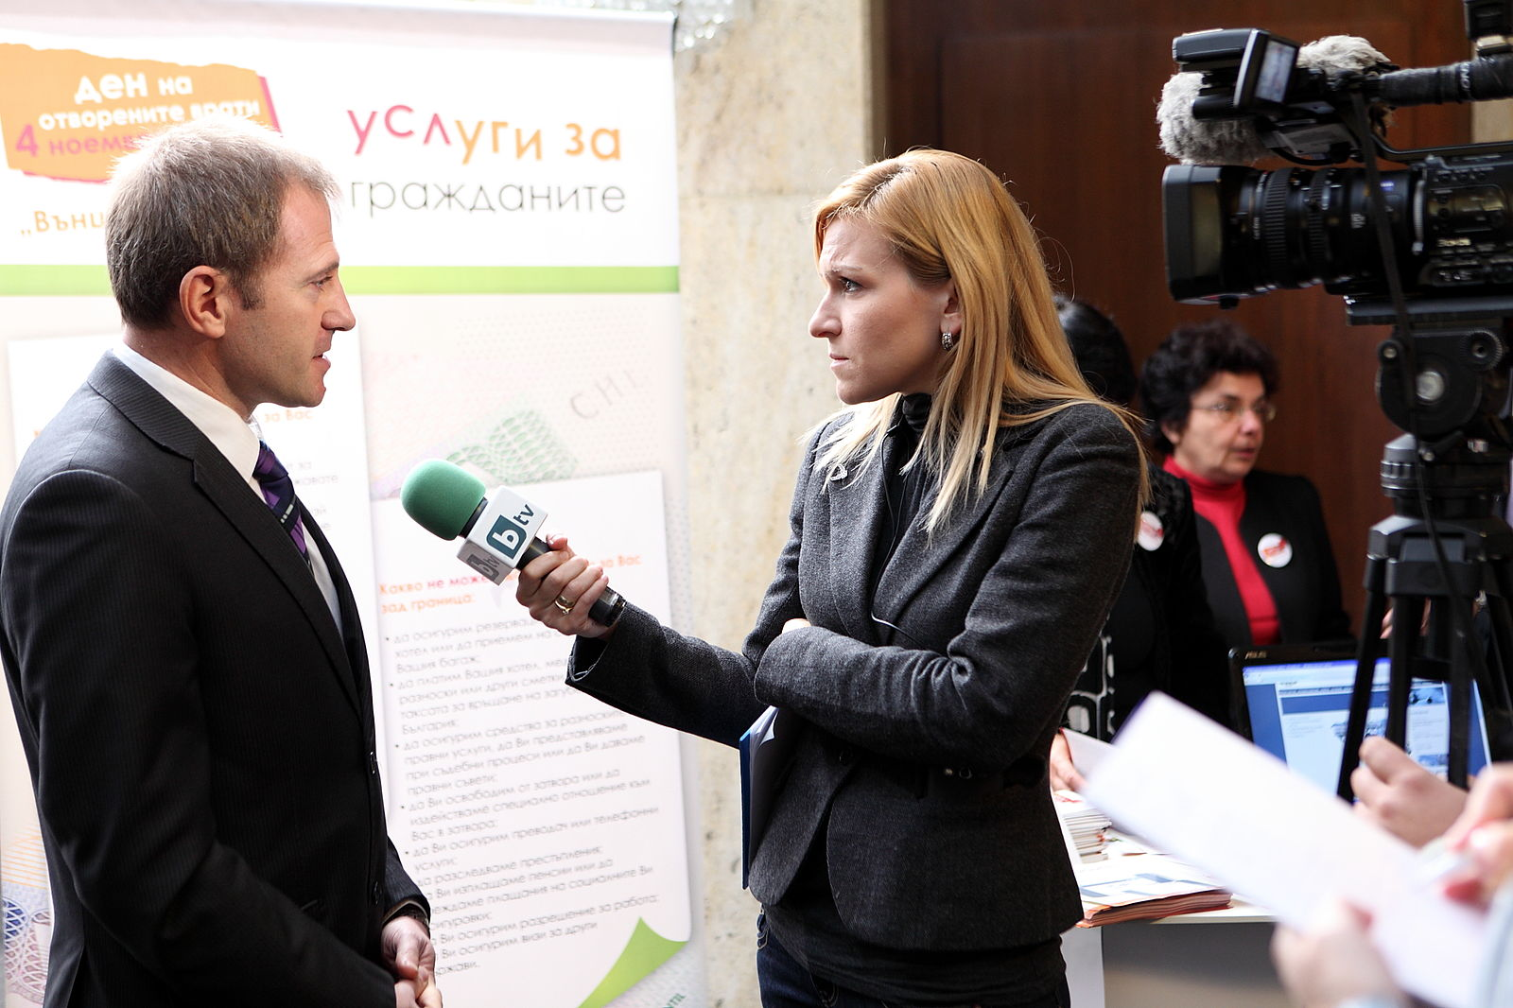
Semi-structured interviews
Why?
gather qualitative data about users to understand the problem
can help identify key differences between designer and target user
How?
ask open-ended questions
bring along a “cheat sheet” to
ensure that you gather all the
information you need
Some tips:
establish trust at the beginning
participant engagement will vary
be flexible, but make sure you get what you came for
consider recording or note-taking to help with recall
Wood, L. E. (1997). Semi-structured interviewing for user-centered design. interactions, 4(2), 48-61.

Slide 15
Defining your audience
Learning about their problem
Semi-structured interview
Analyzing their tasks
Hierarchical task analysis
Modeling users
Personas

Slide 16
Hierarchical task analysis
Why?
Understand user workflow
Identify pain points and areas for optimization
How?
Decompose tasks into 4-8 sequential steps
Identify patterns, sequences and skips in the tasks
An example:
Hackos, J. & Redish, J. (1998). User and Task Analysis for Interface Design. Chichester: Wiley.

Slide 17
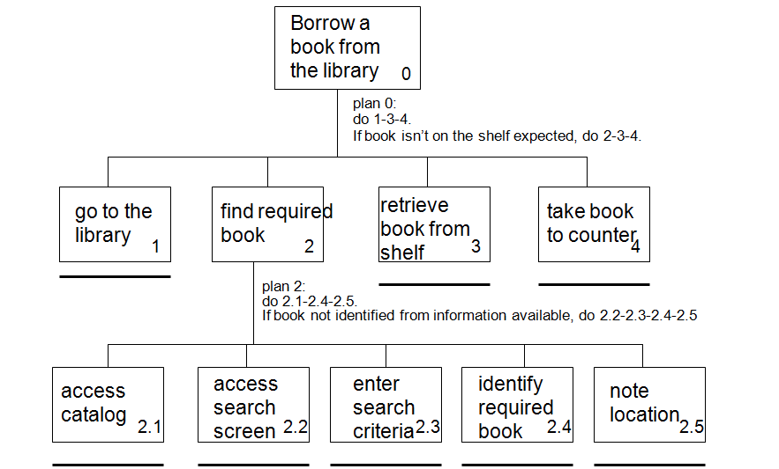
Task analysis example
http://i1206241.blogspot.com/2013/01/task-descriptions-hierarchical-task.html

Slide 18
Defining your audience
Learning about your users
Semi-structured interview
Contextual inquiry
Analyzing users’ tasks
Hierarchical task analysis
Modeling users
Personas

Slide 19
Personas
Why?
mechanism for reasoning about user needs
model behavioral characteristics of target users
doesn’t require access to ACTUAL users
How?
fictionalization
narrative, goals, needs, “pain points”
attributes specific to the problem space
data-driven method* using info from interviews
mapping persona to software features

Slide 20
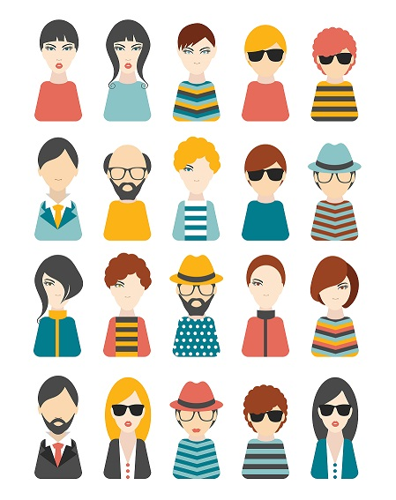
Activity: personas
Goal: come up with 3 personas that characterize people who might be interested in a public transit app

Slide 21
Now that we’ve got some end users in mind,
what would a prototype look like?

Slide 22
CS Life Skill #1: “Paper prototyping”
Big idea:
Not sure yet whether or not an idea will work?
Making a paper version of an interface is a lot faster and easier than coding a working prototype – start there!

Slide 23
“Paper prototyping” goals
Generate lots of ideas
Engage other people in the design process
Identify potential problems before you waste time coding
Get feedback quickly, from lots of different people
Some tips:
Focus on the big picture, don’t worry about the details
Think about what you want it to do, rather than what you know how to implement (we’ll worry about that later)
Not so into arts and crafts? It doesn’t have to be actual paper… Whiteboard / PowerPoint / Keynote will also do the trick!

Slide 24
Discussion
How did it go?
What did you notice?

Slide 25
CS Life Skill #2: “Architecture diagrams”
Big idea:
Now that you’ve got an idea of what your interface might look like, break that down into manageable pieces so you can get started
This can happen at several levels of detail

Slide 26
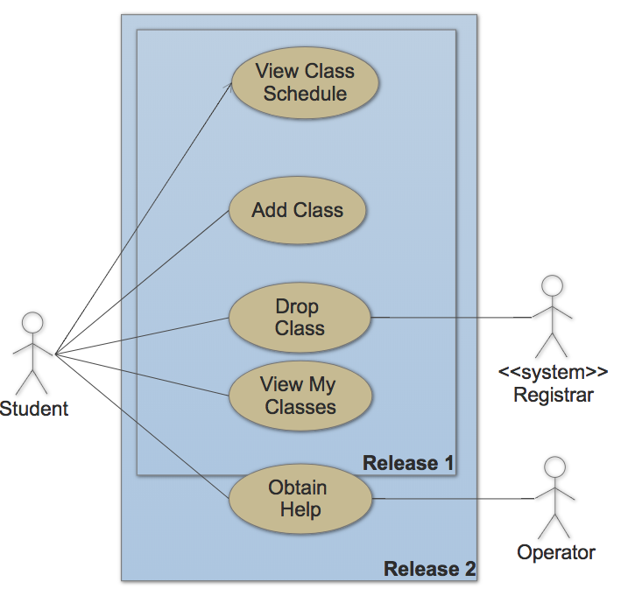
Example: use case diagram (high level)

Slide 27
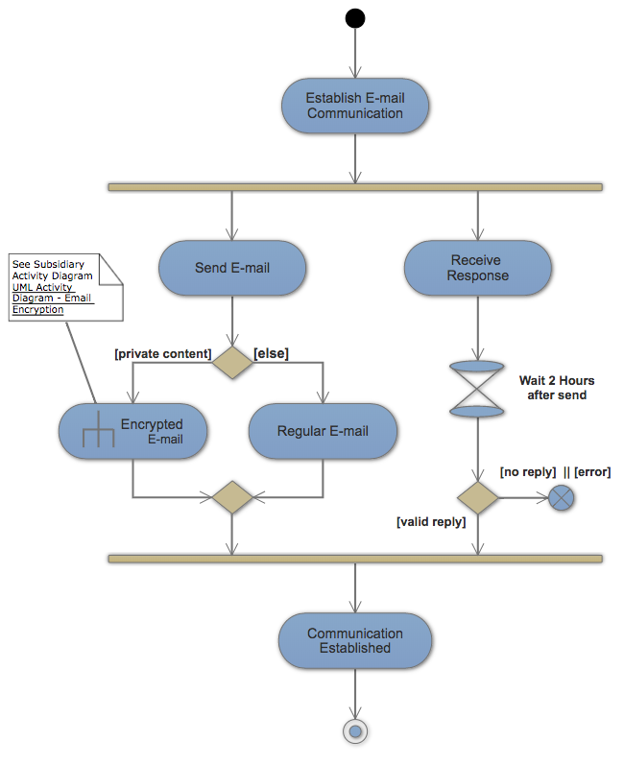
Example: activity diagram (mid level)

Slide 28
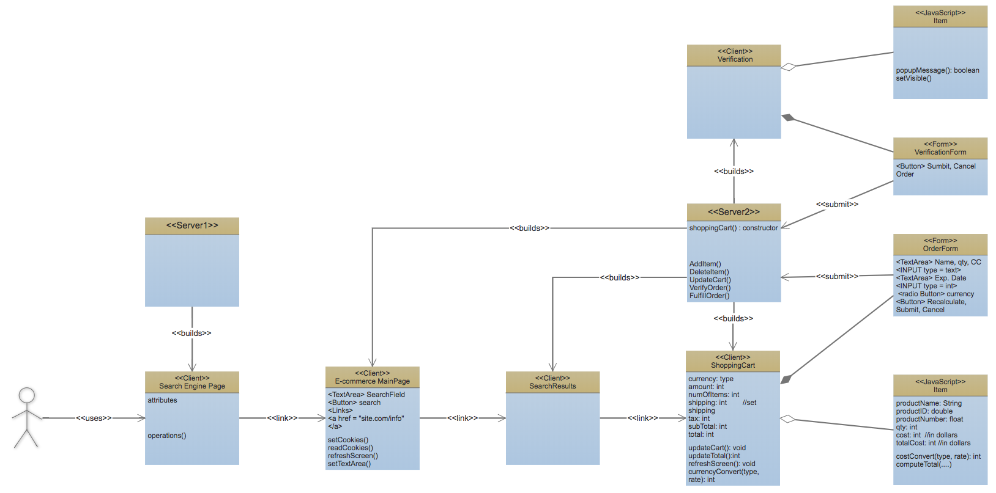
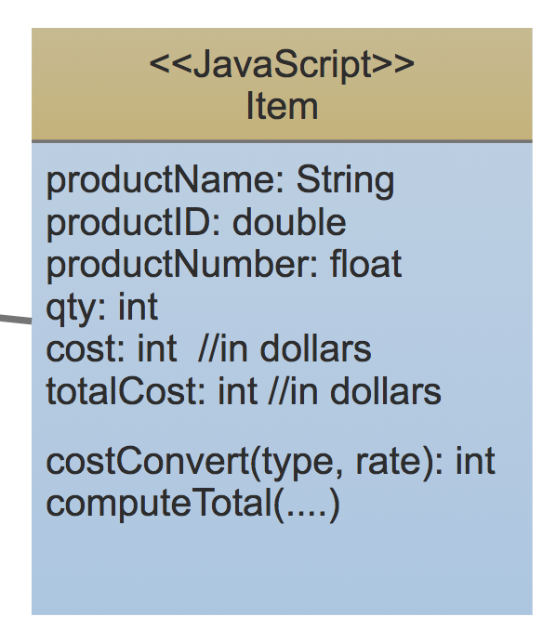
Example: class diagram (low level)

Slide 29
Your turn!
Work with a partner to create a paper prototype for a transit app. Take a picture of your prototype to turn in on PLATO.
Notes:
Create a paper prototype for a transit app

Slide 30
Takeaways
Thinking about your end user early → you’re more likely to build something that actually solves the problem
“Low-fidelity” prototyping saves time and energy by helping identify problems before you commit to code
Architecture diagrams help you plan out your implementation so you don’t run out of time
Also, the process is kinda fun…

